Slide 1
Course Name : Data Structures & Algorithms
EDIT YOUR NAME
Computer Science & Information Systems

Slide 2

Binary Search Trees (BST)
Session 9

Slide 3
Agenda
Introduction
Binary Search Trees
Creation
Traversal
Deletion
Summary

Slide 4
Introduction
Definition of Binary Search Tree: A binary search tree may be empty. A nonempty BST satisfies the following properties:
All key elements in the tree are distinct or unique.
The keys (if any) in the left subtree of the root are smaller than the key in the root.
The keys (if any) in the right subtree of the root are larger than the key in the root.
The left and right subtrees of the root are also BSTs.

Slide 5
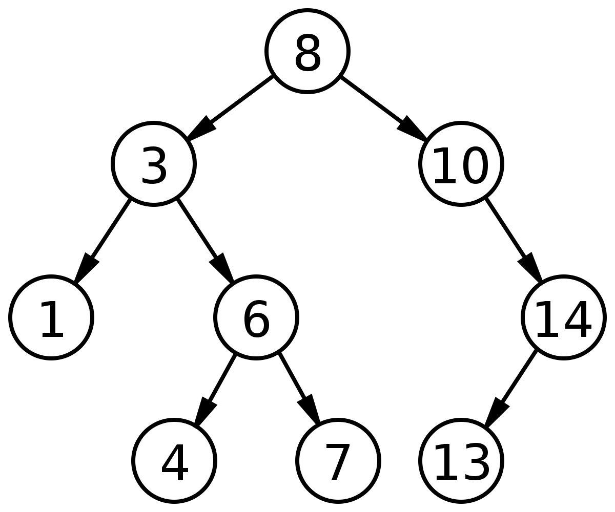
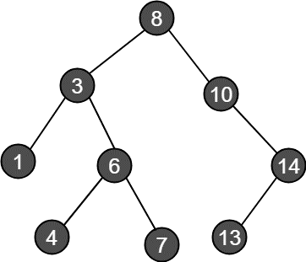
Example of BST

Slide 6
BST CREATION
25, 8, 28, 20, 5, 47, 33, 21, 15
25
8
28
5
20
47
15
21
33

Slide 7
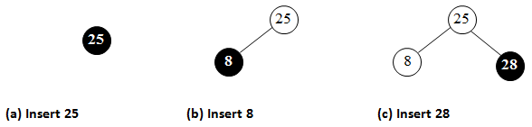
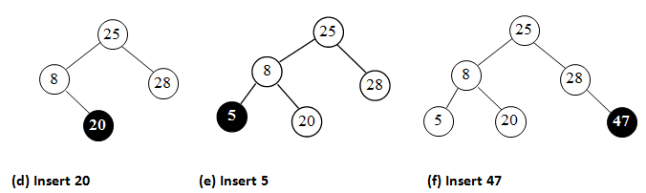
How to Create?
input elements are: 25, 8, 28, 20, 5, 47, 33, 21, 15

Slide 8
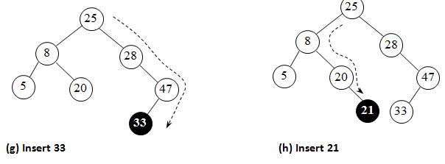
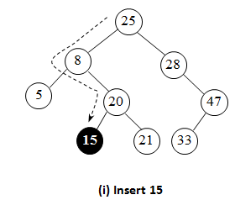
How to Create?...

Slide 9
Algorithm
■ Algorithm CreateTree(p, e)
// p – pointer to the root
// e – element to be inserted
if p = NIL {
p = Getnode()
info(p) ← e
left(p) ← right(p) ← NIL
}
else if e = info(p) {
Write "Duplicate element. Insertion can't be done"
return p
}
if e < info(p)
left(p) ← CreateTree(left(p), e)
else
right(p) ← CreateTree(right(p), e)
return p
end CreateTree.

Slide 10
Traversal - Algorithms
■ Algorithm Preorder(p)
// p – pointer to the root
if p ≠ NIL {
Write "Node visited: ", info(p)
Preorder(left(p))
Preorder(right(p))
}
end Preorder.

Slide 11
Inorder
■ Algorithm Inorder(p)
// p – pointer to the root
if p ≠ NIL {
Inorder(left(p))
Write "Node visited: ", info(p)
Inorder(right(p))
}
end Inorder.

Slide 12
Postorder
■ Algorithm Postorder(p)
// p – pointer to the root
if p ≠ NIL {
Postorder(left(p))
Postorder(right(p))
Write "Node visited: ", info(p)
}
end Postorder.

Slide 13
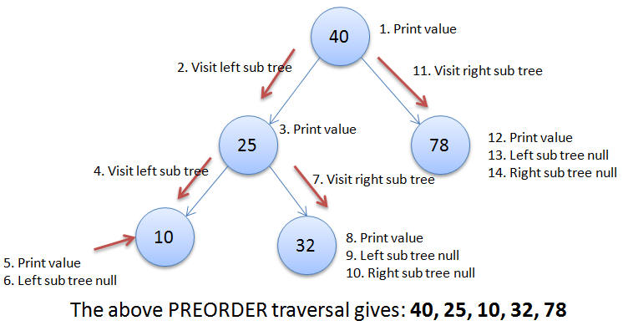
Preorder Traversal

Slide 14
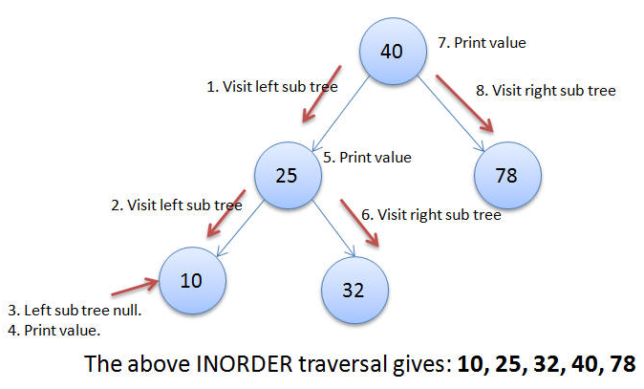
Inorder Traversal

Slide 15
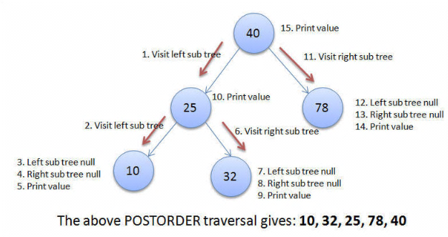
Postorder Traversal

Slide 16
Tree Deletion
Case 1: Deleting a leaf
Deleting a node with no children (leaf node) is easy, as you can simply remove it from the tree. No additional statements for linking are needed.
Case 2: Deleting a node with one child
When a node Delete it and replace it with its child.
Case 3: Deleting a node with two children
This case is the most difficult one. To handle this case, we first find the inorder successor of the key node and swap.

Slide 17
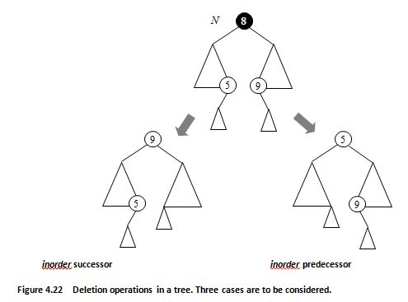
Concept

Slide 18
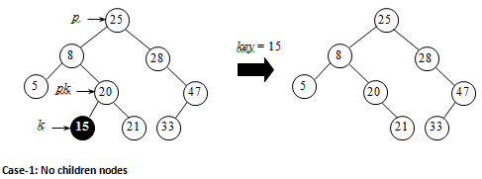
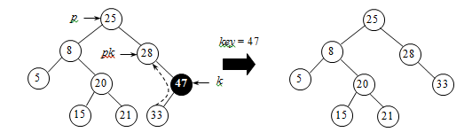
Example
(b) Case-2: Right subtree is absent

Slide 19
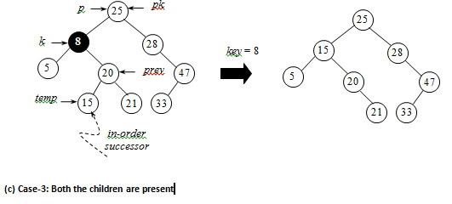
Deletion…

Slide 20
C Function
TNODE DeleteBSTNode(TNODE p, int x)
{
TNODE k, prev; /* k points to key node */
TNODE pk; /* parent of k */
TNODE temp;
k = p;
pk = NULL;
/* just one key node */
if (p->info == x && p->left == NULL &&
p->right == NULL)
{
p = NULL;
return p;
}

Slide 21
Contd…
/* find the key node */
while (k != NULL && k->info != x)
if (x < k->info)
{
pk = k;
k = k->left;
}
else
{
pk = k;
k = k->right;
}
if (k == NULL)
{
printf("Node not found\n");
return p;
}

Slide 22
/* Case-1 and Case-2 */
temp = k;
if (k->left == NULL)
{
if (pk == NULL) /* key is root with no left subtree */
p = p->right;
else
if (k->info < pk->info)
pk->left = k->right;
else
pk->right = k->right;
}
else
if (k->right == NULL)
{
if (pk == NULL) /* key is root & no right subtree */
p = p->left;
else
if (k->info > pk->info)
pk->right = k->left;
else
pk->left = k->right;
}

Slide 23
else /* Case-3 */
{
// Node has two children - get max of left subtree
temp = k->left;
prev = k;
while (temp->right != NULL)
{
prev = temp;
temp = temp->right;
}
k->info = temp->info;
if (prev == k)
prev->left = temp->left;
else
prev->right = temp->left;
}
free(temp);
return p;
}

Slide 24
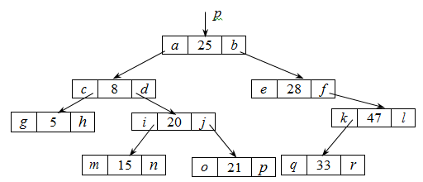
Example

Slide 25
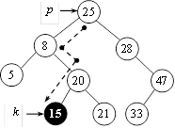
Tree Search
■ Algorithm TreeSearch(p, x)
if p = NIL or x = info(p) return p
if x < info(p)
return TreeSearch(left(p), x)
else
return TreeSearch(right(p), x)
end TreeSearch

Slide 26
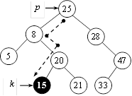
Iterative version
■ Algorithm Iterative_TreeSearch(p, x)
while p ≠ NIL and x ≠ info(p) do
if x < info(p)
p ← left(p)
else
p ← right(p)
return p
end Iterative_TreeSearch.

Slide 27
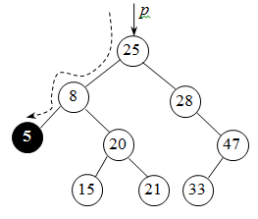
Finding Minimum and Maximum
■ Algorithm TreeMinimum(p)
// p – pointer to the root
if p = NIL return -1 // empty tree
while left(p) ≠ NIL do
// p points left most node
p ← left(p)
return info(p)
end TreeMinimum.

Slide 28
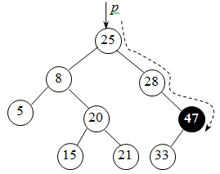
Max
■ Algorithm TreeMaximum(p)
// p – pointer to the root
if p = NIL return -1
while right(p) ≠ NIL do
p ← right(p)
return info(p)
end TreeMaximum

Slide 29
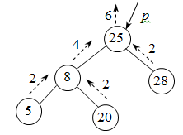
Node Counting
■ Algorithm TreeNodeCount(p)
// p – pointer to the root
// returns n+1 nodes
if p = NIL
return 1
else
return TreeNodeCount(left(p)) + TreeNodeCount(right(p))
end TreeNodeCount.

Slide 30
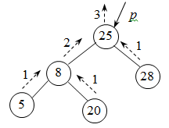
Counting Leaf Nodes
■ Algorithm TreeLeafCount(p)
// p – pointer to the root
// returns the number of leaf nodes
if p = NIL return 0
if left(p) = NIL and right(p) = NIL
return 1
else
return TreeLeafCount(left(p)) + TreeLeafCount(right(p))
end TreeLeafCount.

Slide 31
Thank You

